Slide 1
1.3. STAKEHOLDERS IN BUSINESS
Intro
Definition & Meaning
Roles
Classification – Internal & External
Issues

Slide 2
STAKEHOLDERS IN BUSINESS & CLASSIFICATION
Individuals and groups with interests , expectations and demands about what business should provide to society.
They may be directly or indirectly connected to the organizations and its environment.
Major stakeholders comprises of its employees, its creditors, directors, suppliers, the owners, customers, the government and the whole community .

Slide 3
ROLE OF STAKEHOLDERS IN BUSINESS
Voting and Decision making
Managing and supervising position in an organization.
Fulfilling responsibilities for society and environment.
Project Planning

Slide 4
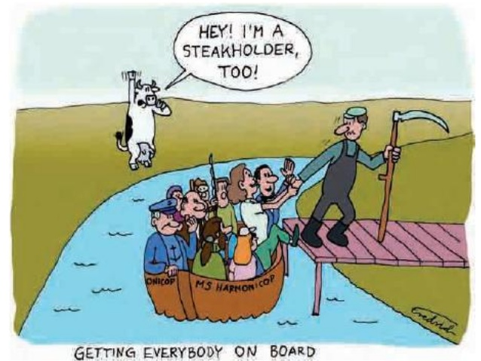

Slide 5
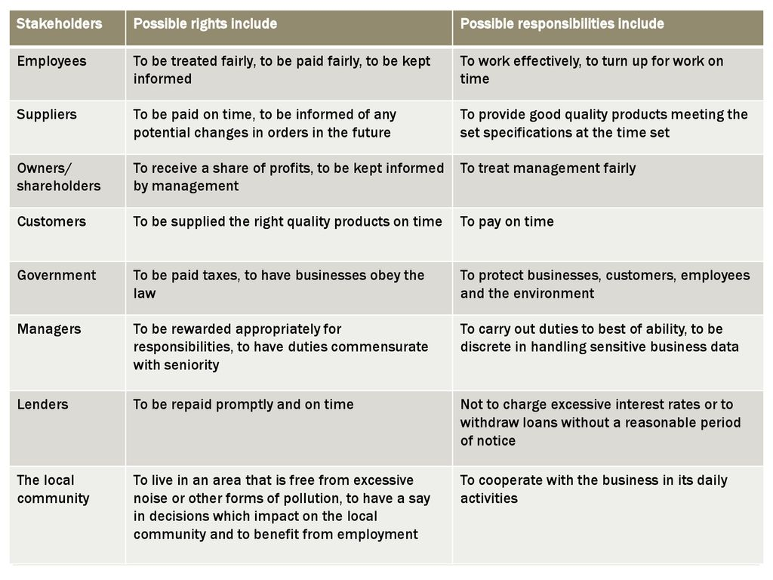

Slide 6
ISSUES IN STAKEHOLDER MANAGEMENT
Juggle different demands and compromise
Relationship with stakeholders
Leadership and commitment
Communication between the organization & stakeholders
Influence and interests of stakeholders
Perception and impact of stakeholders
Aligning values and motivation of stakeholders
Need to relocate cheaper production facilities overseas
Investors – low costs – profit – less pay to employees
Might rise price for customers

Slide 7
